Slide 1
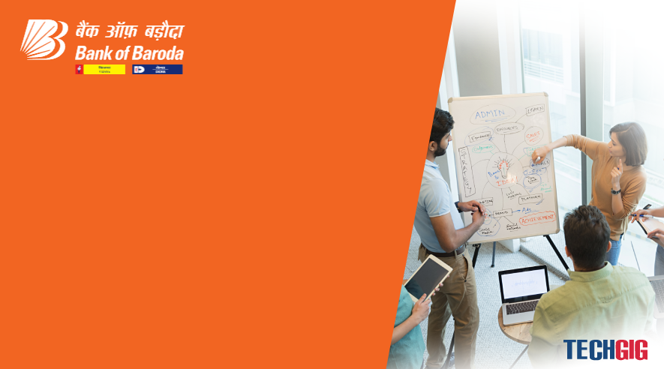

Bank of Baroda Hackathon - 2022
Technology Partner
Team Name : Image Lab
Automated Cheque Processing
Your team Bio : 1.D.Sabarinathan
2.M.Parisa Beham
3.R.Tamilselvi
4.H.Mohamed Sherif
Date :

Slide 2
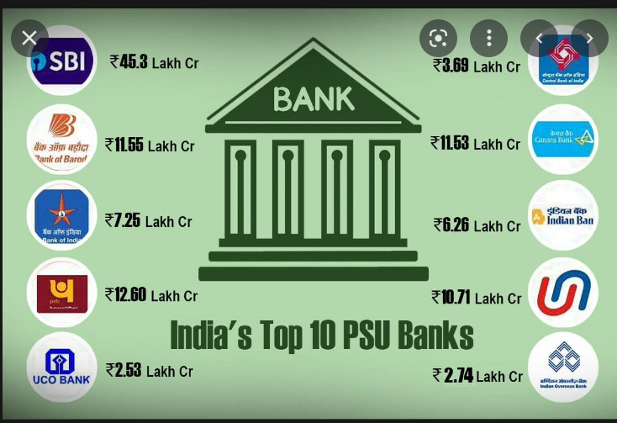


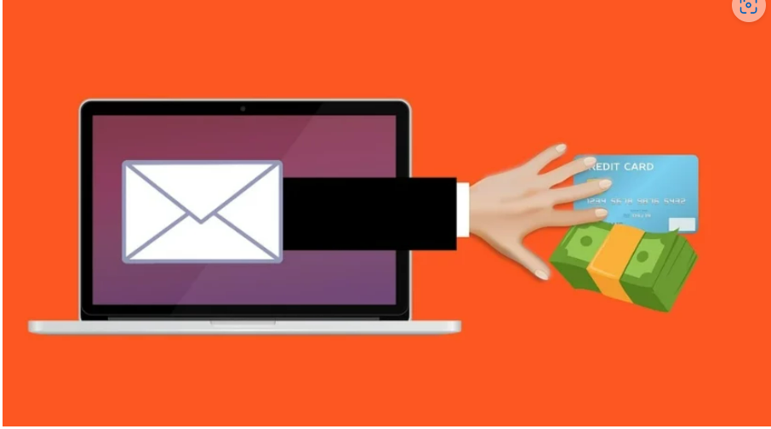
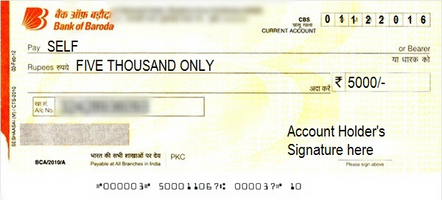
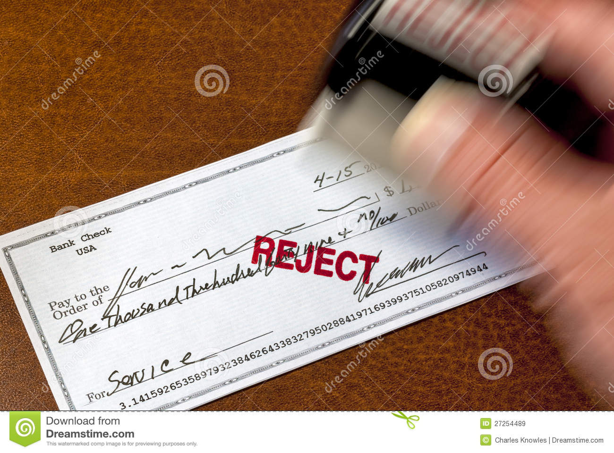
Problem Statement?
PSU banks is set to open about 300 branches in unbanked areas by December 2022.
There are many branches of Bank of Baroda all over India. Their branches are in rural areas also. There is a risk of Fraud
Though Cheque transactions are possible today, still the process are manual and there is a delay in the process..
All Manual Verification is a Time consuming Process and errors/mismatch leads to rejection.
Large volumes of Cheques clearance and human intervention.

Slide 3
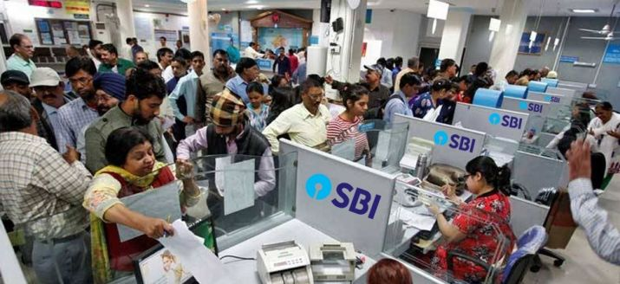
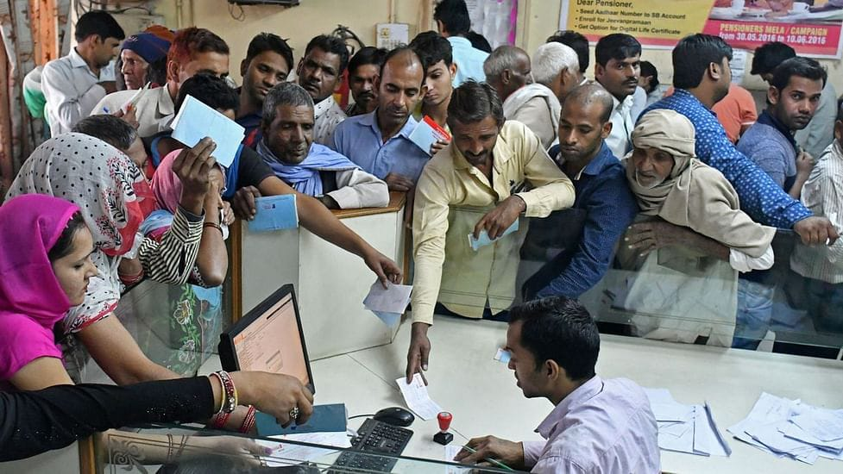
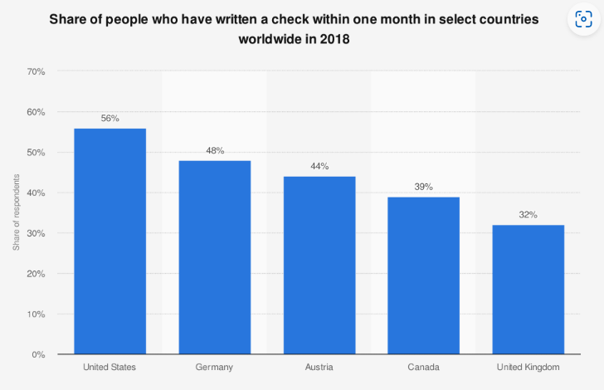
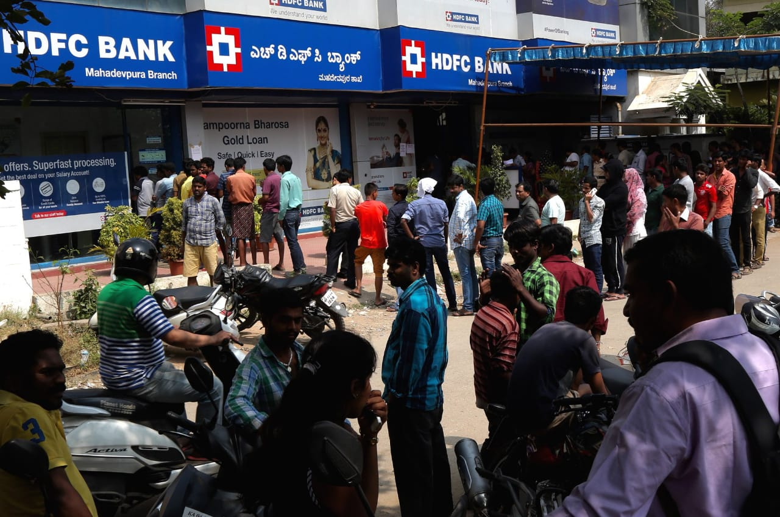
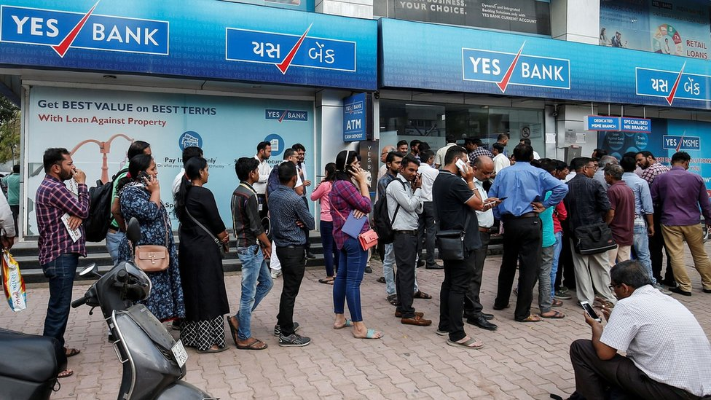
User Segment & Pain Points:
Banks would be Early Adopters of our product.
Increased Work pressure of Bank OffIcers
More Cheque are processed in the bank daily
The Officers need to verify the cheques filled by customers in long queues.
Waste of Time for Customers

Slide 4
Pre-Requisite: 1. Scanner to scan the cheques 2. AI based Training & Testing
Azure tools or Resources
1. 8 GPU or 16GPU NVIDIA device for training the model.
2. Python Packages i.e Tensorflow , Pytorch, CV2, Pillow
3. Azure handwrittern OCR recognizer or training the handwritten
recognition model
4. Signature Matching Engine

Slide 5
Key Differentiators & Adoption Plan:
EXISTING ALTERNATIVES | OUR WORK
Manual check Processing | Deep learning based cheque region detection and extract the information.
Digital Signature verification | Signature Matching Engine. we are planning to create deep learning based signature matching network.
Manual Data Entry | The dataentry will be automated.
Prone to manual error | Extract the cheque information with more than 95% accuracy.

Slide 6
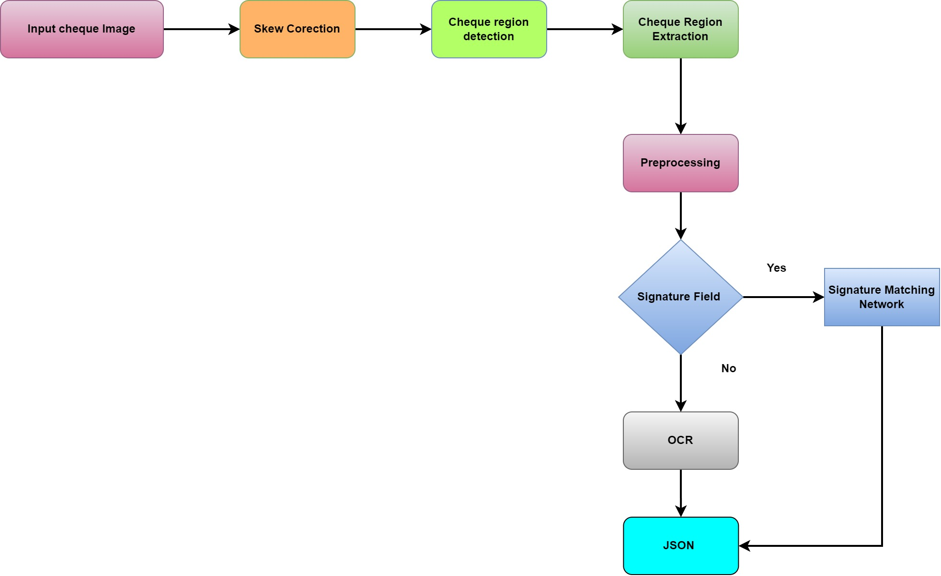
Supporting diagrams, screenshots, if any:
GitHub Repository Link:
https://github.com/dsabarinathan/cheque-extract

Slide 7
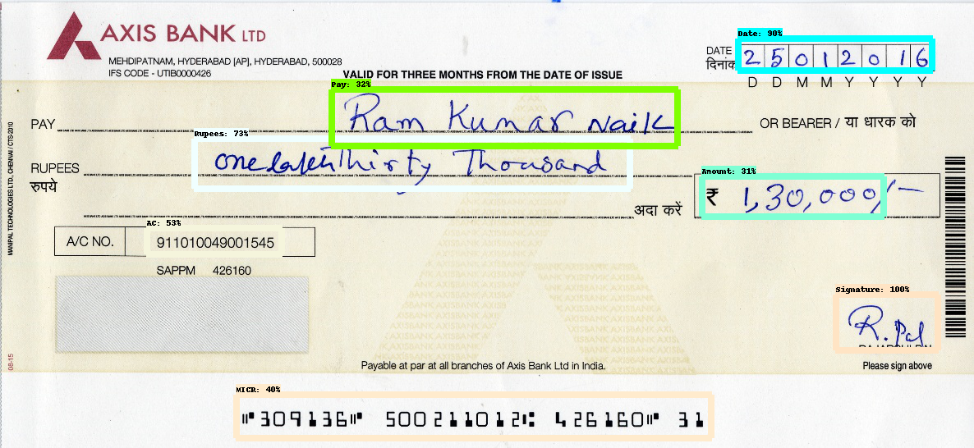
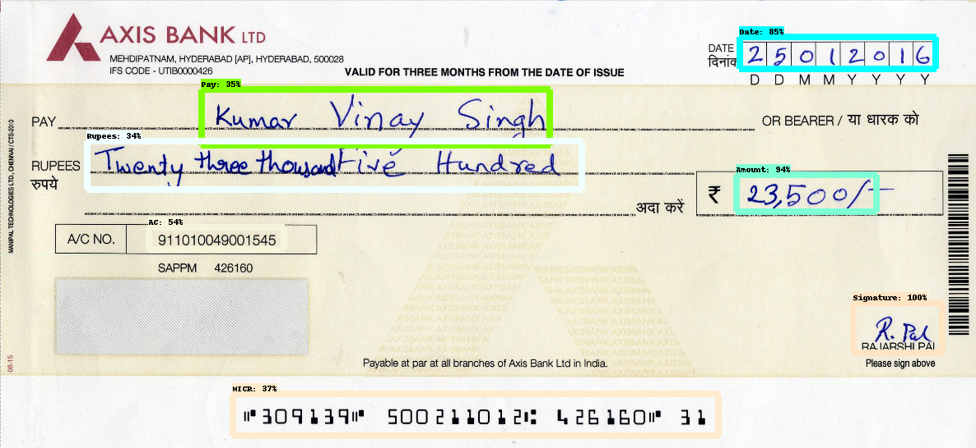
Any Supporting Functional Documents:

Slide 8
Thank You
TEAM MEMBERS:
1.

